Slide 1
Movie/Web Series Recommendation System
TeamEpic

Slide 2
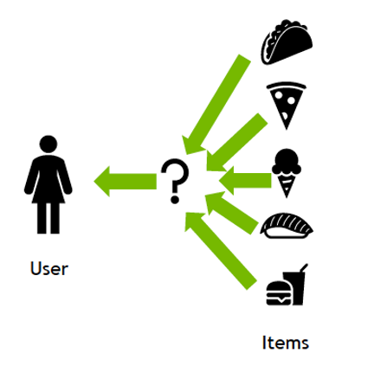
What are Recommendation Systems ?
A recommendation system can be thought of as a subclass of information filtering system.
Having a recommendation engine makes browsing content easier.
Helps users find things they wouldn't have thought to look for on their own.

Slide 3
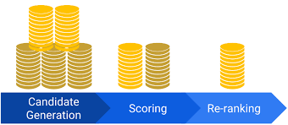
Primary Components of RS
Candidate Generation- Divide huge corpus and generate a much smaller subset of candidates.
Scoring- Scores and ranks the candidates in order to select the set of items.
Re-ranking- Removes items that the user explicitly disliked.

Slide 4
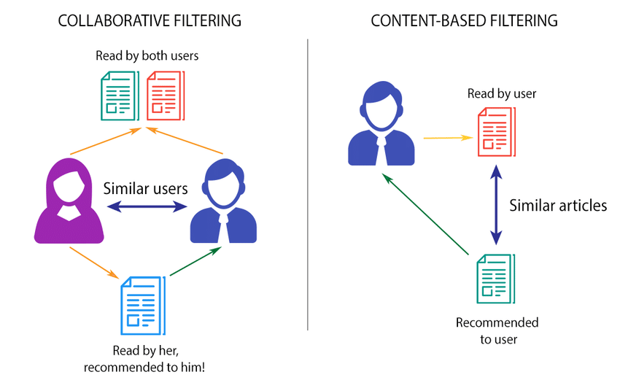
Candidate Generation
Candidate generation is the first stage of recommendation.
Two common candidate generation approaches:
Content Based Filtering
Collaborative Based Filtering

Slide 5
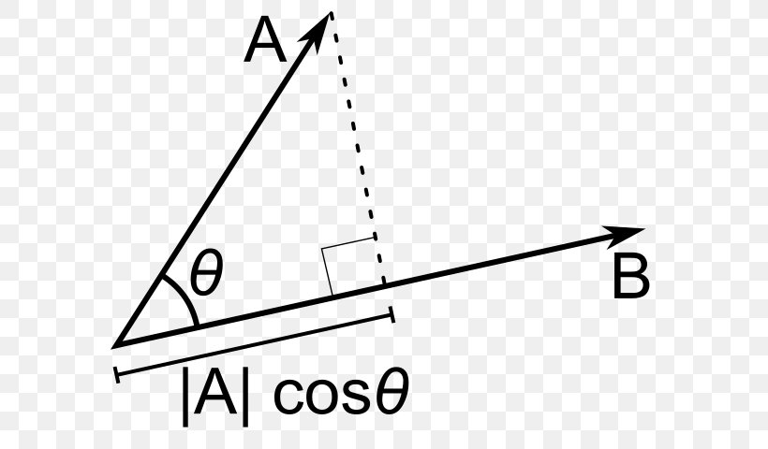
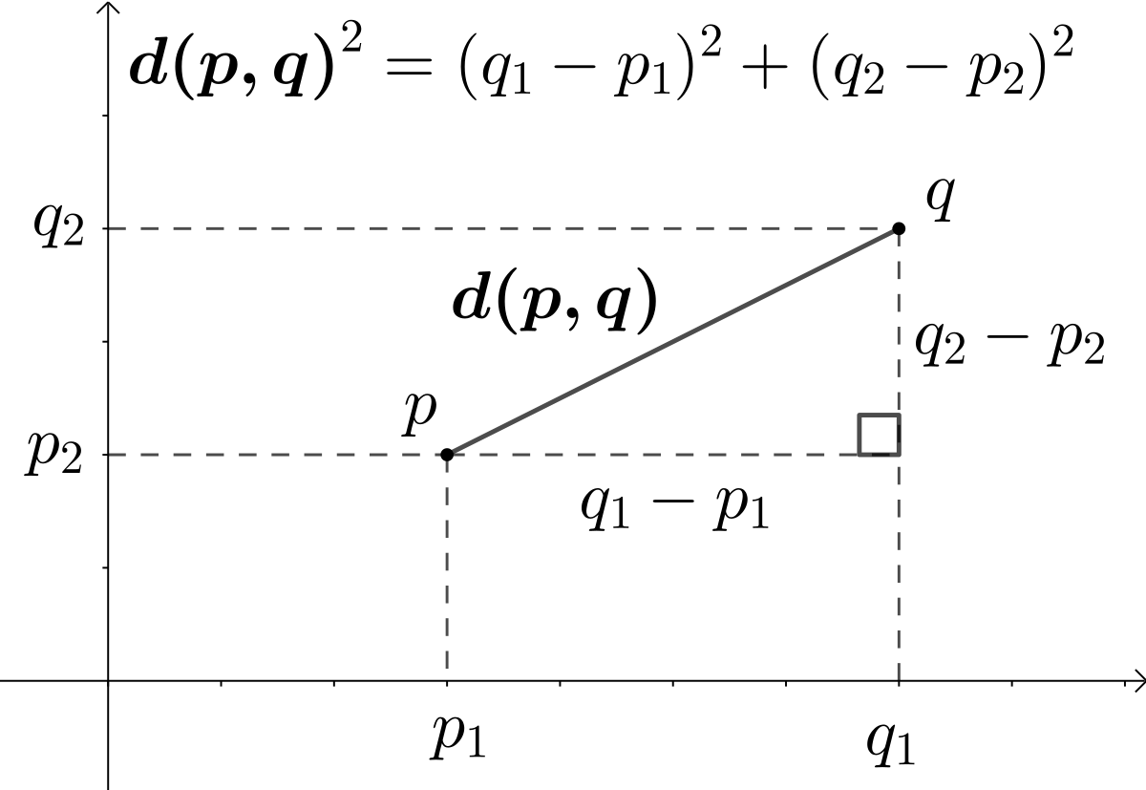
Similarity Measures
Cosine
s(q,x) = cos(q,x)
Dot Product
s(q,x) = ||x||||q|| cos(q,x)
Euclidean Distance

Slide 6
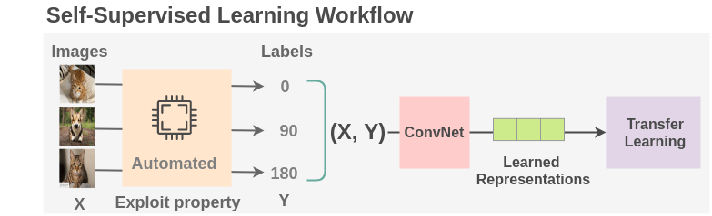
Type of Learning used in RS - Self Supervised Learning
Method of machine learning that can be regarded as an intermediate form between supervised and unsupervised learning.
It is a type of autonomous learning using artificial neural networks that does not necessarily require sample data classified in advance by humans.

Slide 7

Type of Data Required
Data is the single most important asset.
Essentially, we need to know some details about our users and items.
If the data is limited to users and items then we can start with content-based approaches.
If we have a large number of user interactions, we can experiment with more powerful collaborative filtering.

Slide 8

Cont...
There is a wide spectrum of pre-processing methods.
Appropriate method depends on what we what to achieve during processing.
Some simple methods which may apply-
Tokenization: Splitting the sentence into words.
Lower Casing: Converting a word to lowercase.
Stemming: Transforming a word to its root form.
Removal of Stop Words: Stop words are commonly used words (a, an, the, etc.)
Lemmatization: Reduces the words to a word existing in the language.

